Slide 1
Update to our Future Story
Regional Assembly 2018
Christian Church
In Oregon &
SW Idaho

Slide 2
Update to our Future Story
Future What??

Slide 3
Update to our Future Story
From 2012-16
We listened
We prayed
We pondered
We grew our geography
We grew our vision

Slide 4
Update to our Future Story
In 2016 we launched a
Future Story…..
We hoped that God would USE us to share good news in the Northwest and Beyond

Slide 5
3 Transitions
Moving from living in a shared history to living into a shared future
Moving from indirect institutional connections to individual/congregational relationships
Moving from a Co-Ministry style to a Team Ministry style of leadership

Slide 6
3 Strategies for God to USE us
U nite — maximizing our efforts by bringing together human
resources.
S upport — each other in ministry by sharing resources
effectively.
E quip— our leadership with the skills required in a changing
world and changing church.

Slide 7
Update to our Future Story
We formed an implementation team to keep us on track and moving forward

Slide 8
Update to our Future Story
David DeBow
Dick Hamm
Brian Ponzar
Robi Ingram Rich
Stacy Shelton
Cathy Myers Wirt

Slide 9
Update to our Future Story
We reported to our regional board three times a year about the progress on our story

Slide 10
Update to our Future Story
What happened?

Slide 11
We did all the usual stuff AND
Usual stuff
Searching for Pastors
Camps
Women’s Events
Administration
Communication
Commission on Ministry
Congregational Visitation
General Church Committees and Boards

Slide 12
Unite Support Equip
Started using video conferencing
for meetings
lectionary groups
global ministry congregation network
Launched an online
newsletter
enhanced Facebook
updated website format

Slide 13
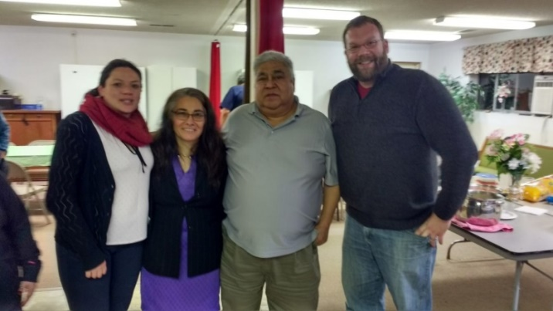
Unite Support Equip
Districts:
parade float & youth events in Santiam River
camps & women’s events Snake River
regional assembly worship Columbia Gorge
Facebook pages Scenic Rivers and Blue Mountain Rivers
Networking of our Spanish speaking ministries by visits with Lori Tapia of Obra Hispana, events for pastors, youth and congregational visits

Slide 14
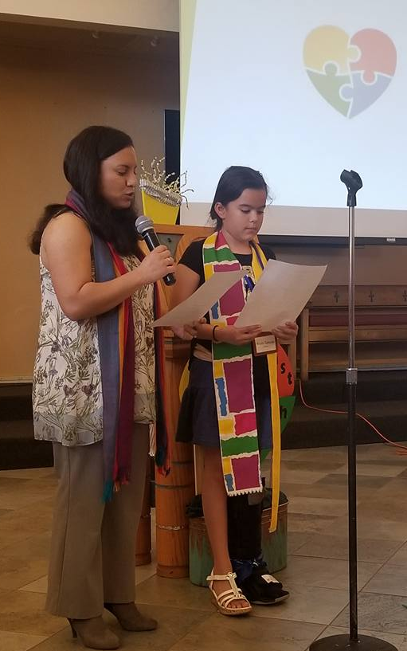
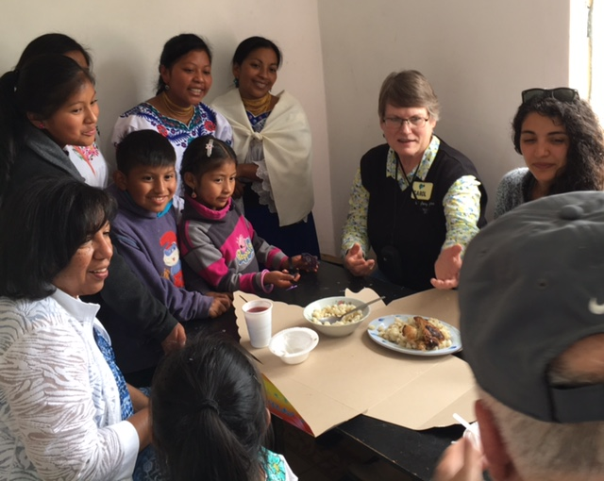
Unite Support Equip
A group from regional church went to Ecuador to visit and work with FEDICE
Over 20 women went to to Arizona to meet with women from the western regions
at the Wild Women of
the West Event April 2018

Slide 15
Unite Support Equip
Launched Pilot project in April 2018 with 8 Regional Elders to network and care for
51 retired clergy and
25 people serving in
specialized ministries

Slide 16
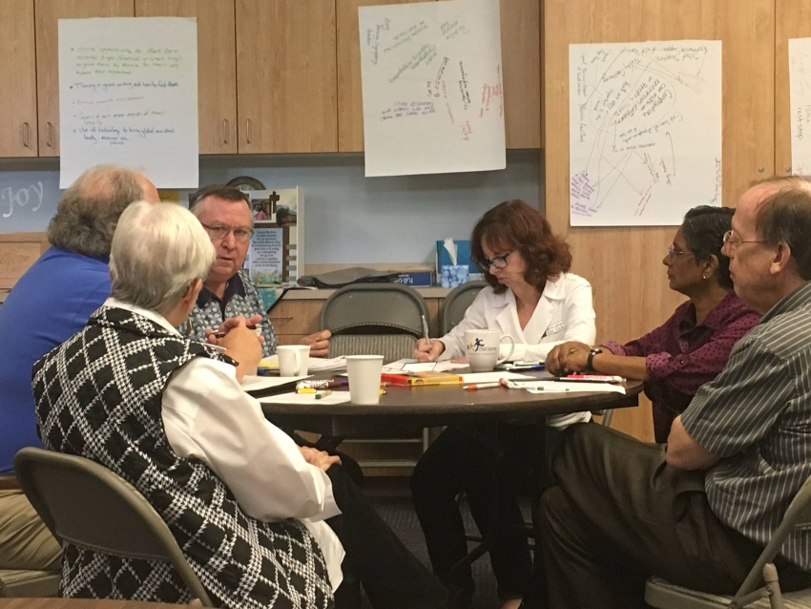
Unite Support Equip
We supported whole church with 3 mission gatherings
Hired new part time staff to support expanding ministries

Slide 17
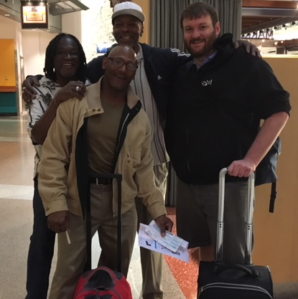
Unite Support Equip
We sent men to the general church men’s gathering to support men’s ministry formation in our region

Slide 18
Unite Support Equip
We sent our regional ministers to training in planned giving & increased the number of named funds benefiting ministries in the church

Slide 19
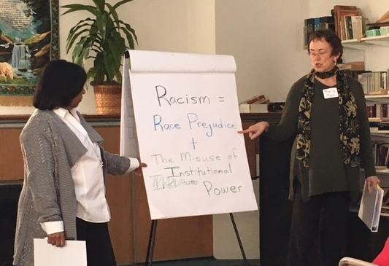
Unite Support Equip
Provided training to 10 Anti-Racism trainers through partnership with Reconciliation Ministries

Slide 20
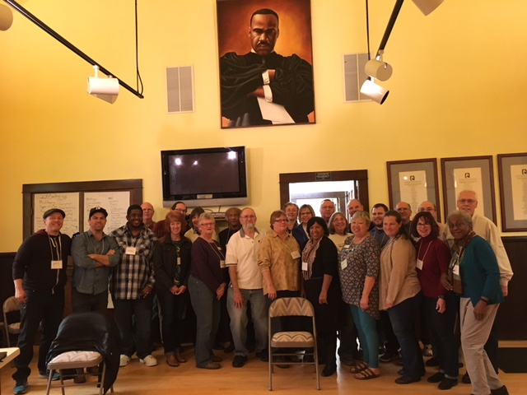
Unite Support Equip
Provided training Anti-Racism sessions to over 100 people
Pastors in the region now required to take the training

Slide 21
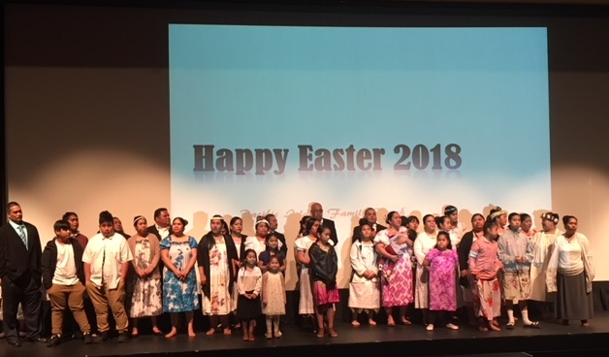
Unite Support Equip
Hosted Chuukese Easter Rally to support developing leadership

Slide 22
Update to our Future Story
Today we Highlight 3 parts of this future story

Slide 23
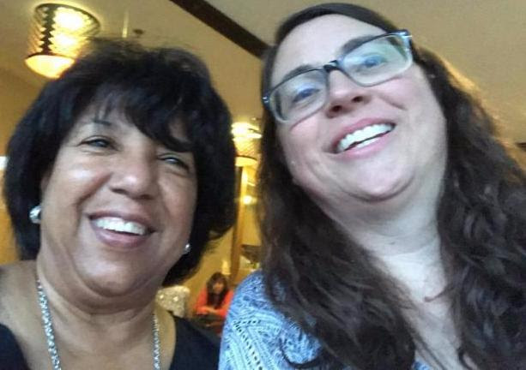
New Staff join the team
Bernice Rivera
New Church Associate
Stacy Shelton
Communications Associate

Slide 24
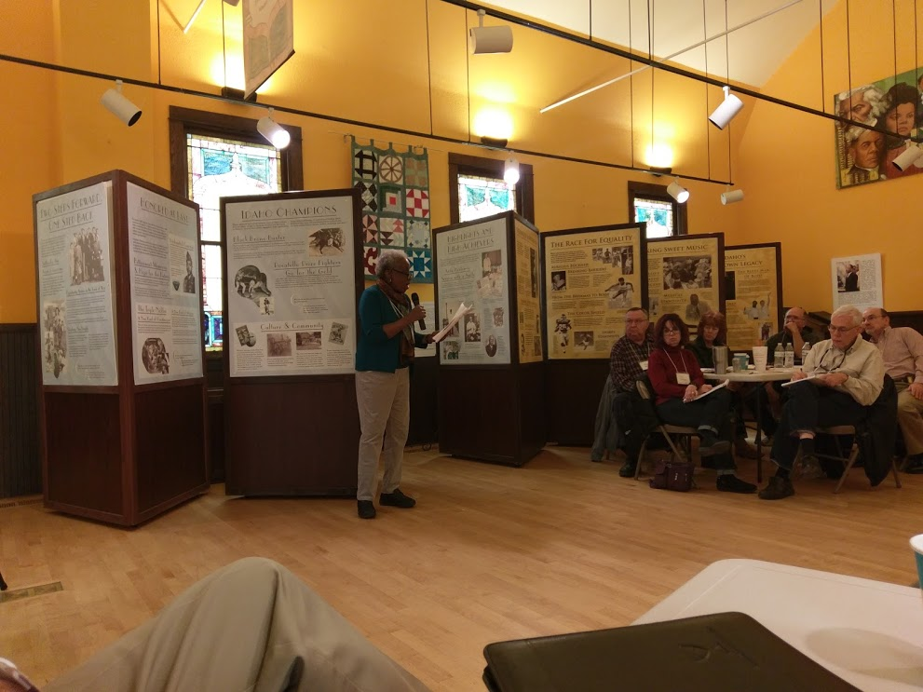
Anti Racism Work moves forward
Anti Racism Trainers

Slide 25
Update to our Future Story
What comes Next?

Slide 26
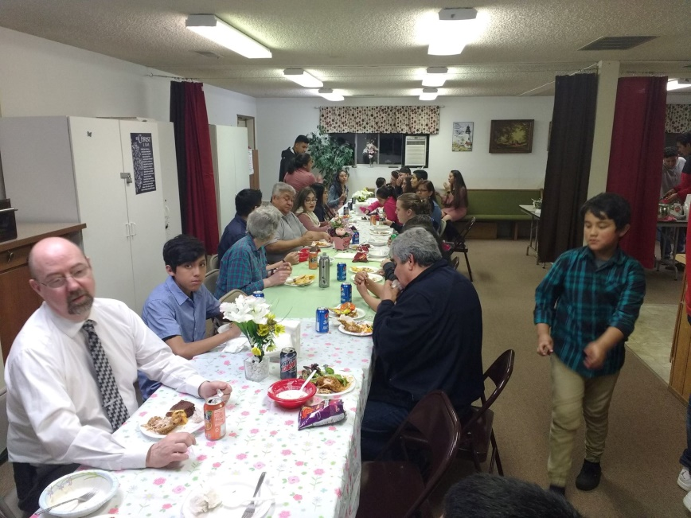
Unite Support Equip
Developing deeper relationships between historic congregations and new congregations
Deepen relationship in districts between congregations
Further utilize technology to share resources/community/support

Slide 27
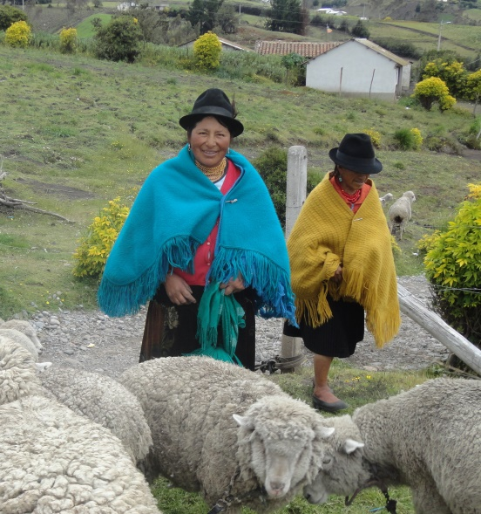
Unite Support Equip
Plan a trip to Ecuador & launch a new Micro-loan project in Maca Atápulo
Add to the number of Global Mission Congregations and network them within our region
Begin conversations for the 2020-2023 Future Story

Slide 28
Unite Support Equip
Pilot Project for men’s ministry
Add staffing for women’s ministry
Increase the number of named funds supporting ministry through endowment

Slide 29
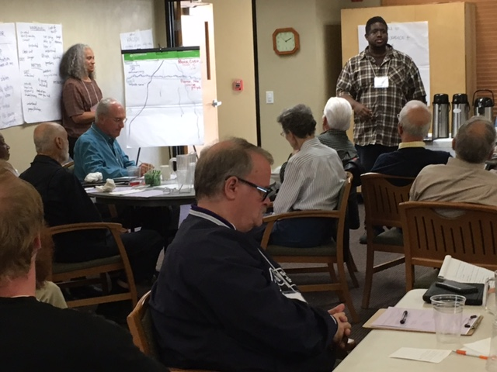
Unite Support Equip
Offer support for technology training for congregations
Provide Anti-Racism training to congregational leadership

Slide 30
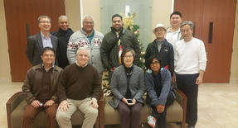
Unite Support Equip
Host North American/Pacific Asian Disciples Convocation in August 2018
Create Clergy Care networks/support system

Slide 31
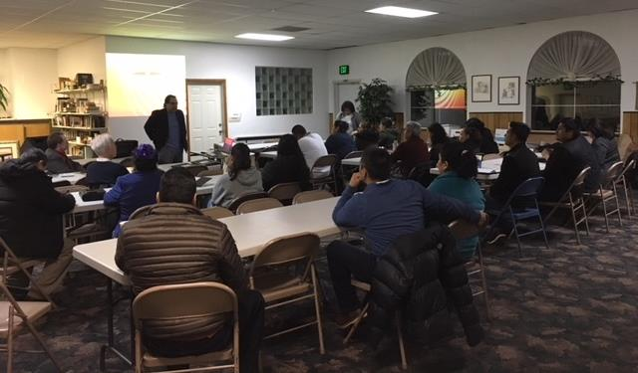
Unite Support Equip
Launch Certificate of Ministry Program in Spanish in partnership with Disciples Seminary Foundation Fall 2018

Slide 32
What comes next!
Xose Escamilla
Disciples Seminary
Foundation
Certificate of Ministry

Slide 33
OFFERING FOR Maca Atápulo
Make Check to Christian Church in OR & SW ID
Write FEDICE in the memo section
Give on line by going to our website:
www.oidisciples.org
Bottom of the home page, there is a link labeled
“Give to Maca Atápulo”
Click this link and follow the directions
THANK YOU

