Slide 1
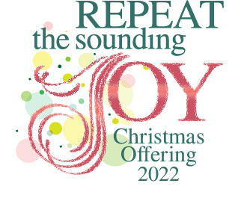
You can give to the Christmas offering by….
A designated gift through your congregational offerings
A gift online at www.oidisciples.org
(link on bottom right of home page)
A gift sent by mail to PO Box 19466, Portland, OR 97280

Slide 2
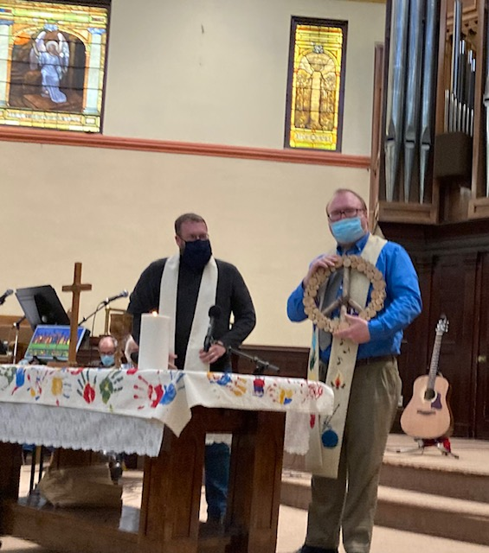
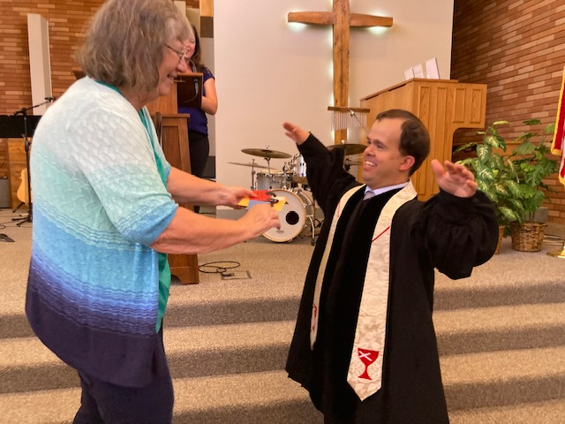
Your Christmas offering assists congregations to call new pastors….
A designated gift through your congregational offerings
A gift online at www.oidisciples.org
(link on bottom right of home page)
A gift sent by mail to PO Box 19466, Portland, OR 97280

Slide 4
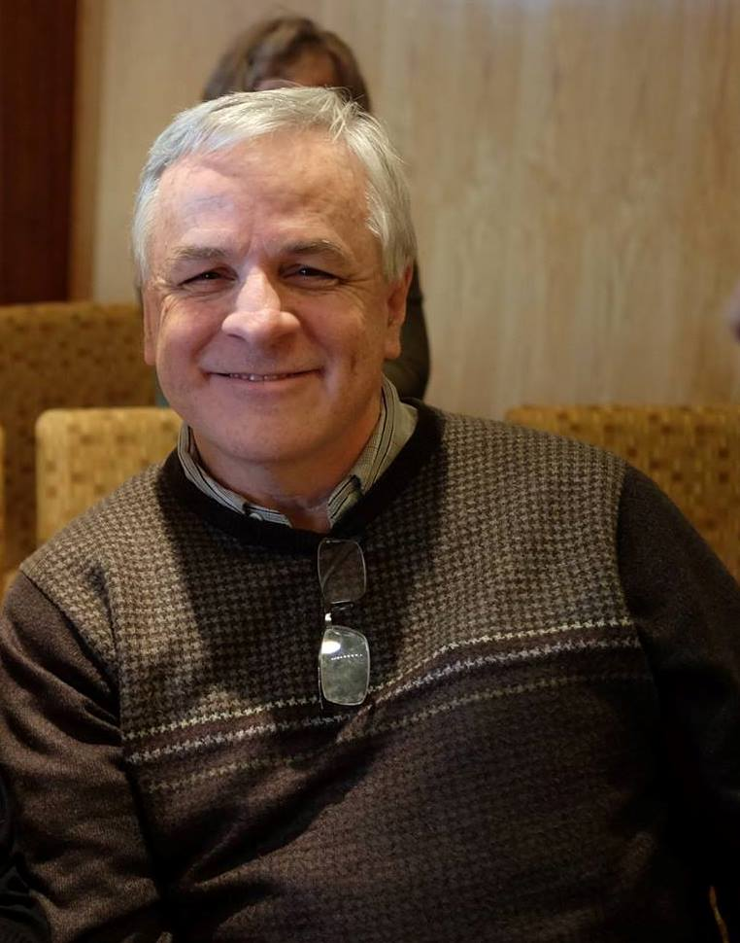
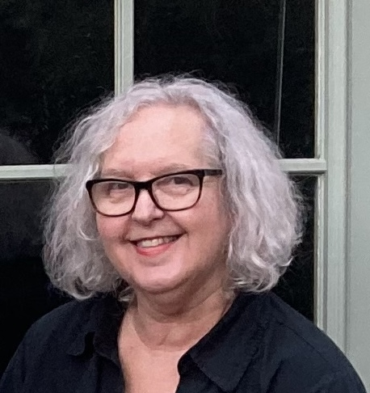
Thank you for your generosity
From
Regional Ministers
Rev. Dr. Douglas A. Wirt
Rev. Dr. Cathy Myers Wirt

Slide 5
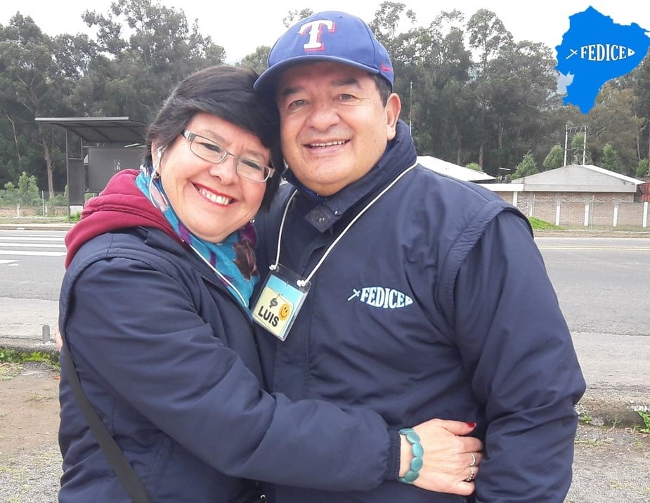
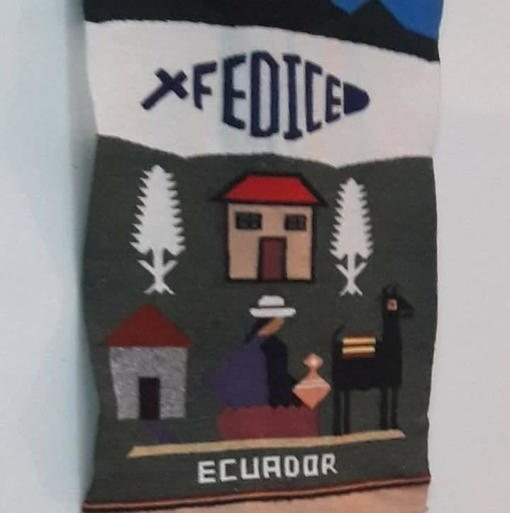
Your Christmas offering assists congregations to connect to global partners….
A designated gift through your congregational offerings
A gift online at www.oidisciples.org
(link on bottom right of home page)
A gift sent by mail to PO Box 19466, Portland, OR 97280

Slide 6
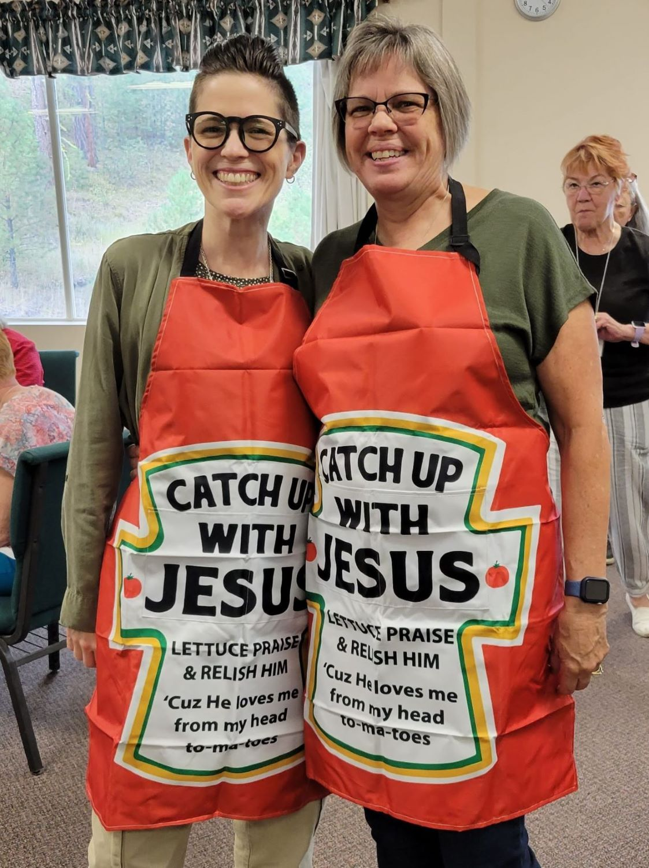
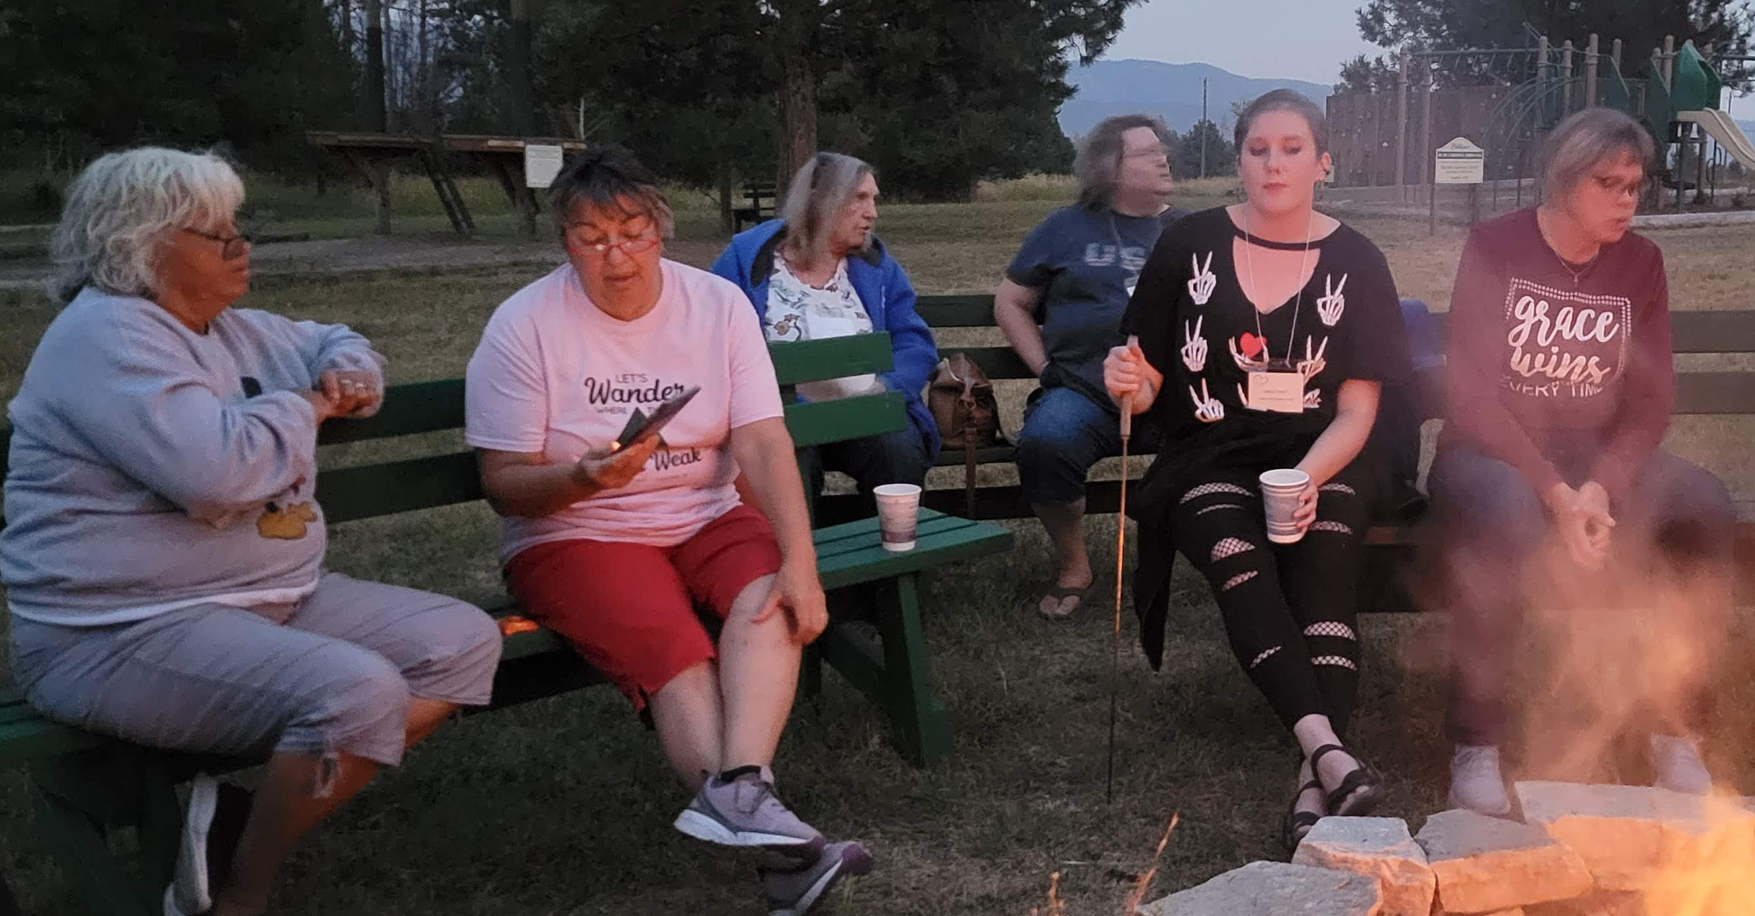
Your Christmas offering assists Disciples Women to gather for support and mission….
A designated gift through your congregational offerings
A gift online at www.oidisciples.org
(link on bottom right of home page)
A gift sent by mail to PO Box 19466, Portland, OR 97280

